Slide 1

MIT COVID19 Challenge Datathon
Team_e_10 Kruti Shah,
Julio Elias
Sep Sabeti

Slide 2
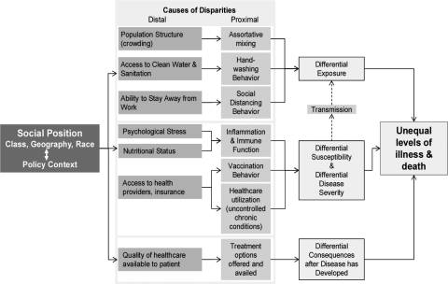
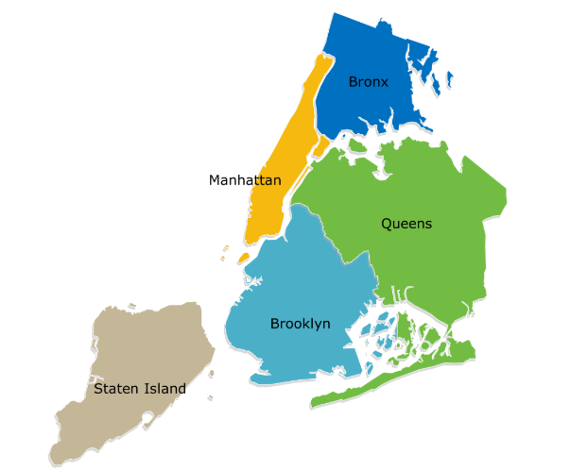
Research Question
For Megacity NYC, do the underlying geographic disparities - health inequality due to poverty and socio-economic demographics related to the severity of the COVID-19, hospitalization, and deaths?
Exposure to COVID-19, geography and health outcomes can be analyzed under the framework proposed by Quinn & Kumar, 2014
..

Slide 3
Project Methodolgy
Start
Framing Research
Question
Data Source
On Premises and Cloud
Feature Engineering
Data Acquisition and Understanding
Feature Selection, Multi Variate Analysis., Pearson Correlation
Exploratory Data Analysis
Wrangling and cleaning
Data Validation and Cleanup
Data Visualization
Bar plots, Heatmaps
Geographic Maps
Analytics and Conclusion
End
Submission

Slide 4
Data Acquisition
Poverty and unemployment
Education level- High School, college, Masters
NYC Socio-Economic
NYC Education
Covid19 cases in NYC Borough wise
Hospitalized cases and death rate
NYC COVID19
Kind of Health Insurance residents have
Age group, Sex and Ethnicity
NYC Health Insurance
NYC Demographic
Actual URL to data is provided in the Reference slide.
Assumption is that COVID cases are reported where the patient is a resident and not where he is hospitalized.
Data is aggregated at borough level and only snapshot is available

Slide 5
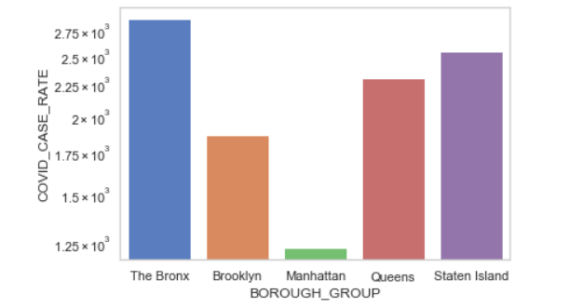
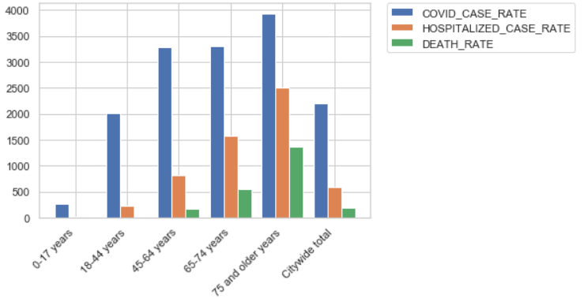
Exploratory Data Analysis
Bronx is the highest hit borough for COVID19 cases.
Maximum COVID19 impact and mortality for Age 75 and older

Slide 6
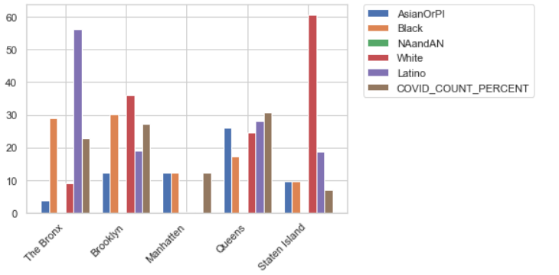
Exploratory Data Analysis
Queens is the most impacted for COVID19. Asians, Whites and Latinos are almost same population.
Staten Island is least impacted Borough. This Borough is dominated by White Population.

Slide 7
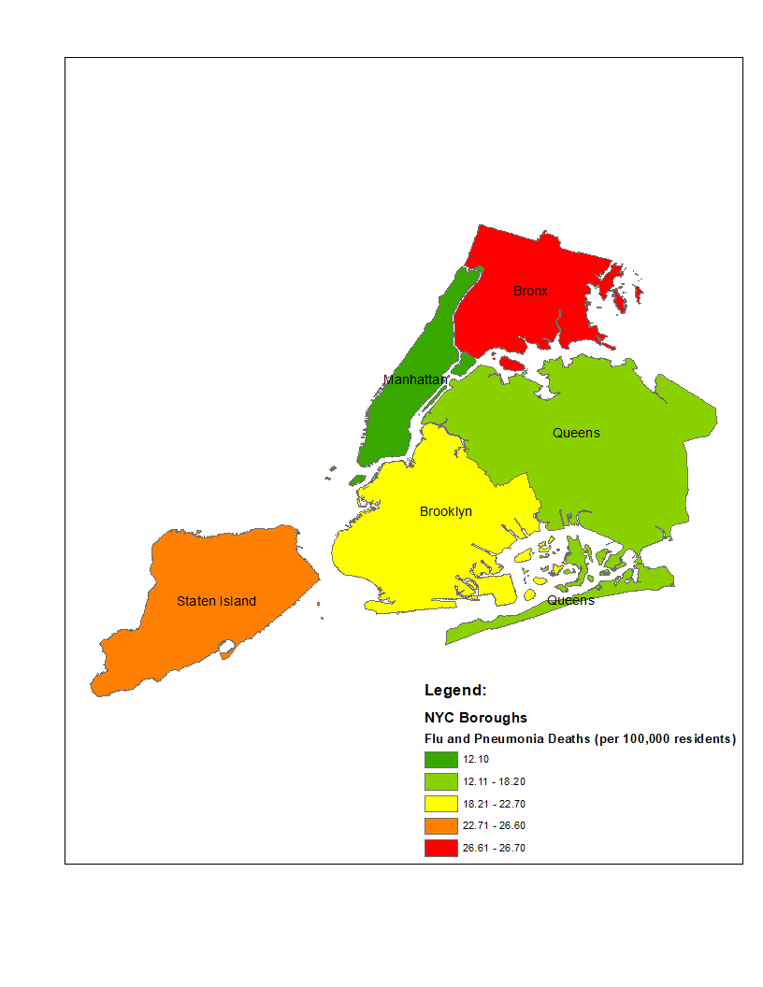
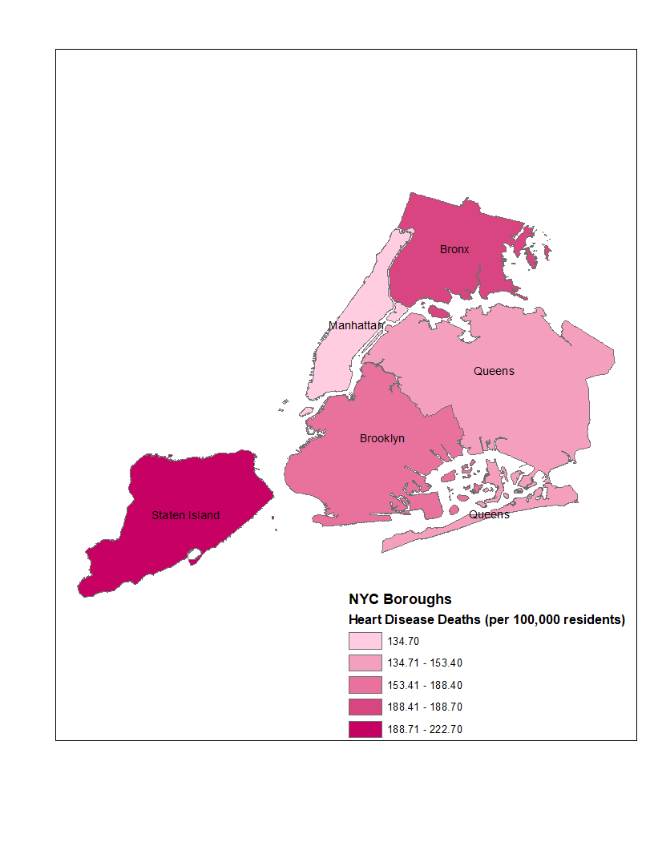
Data Visualization
Prevalent Health Conditions of NYC Residents…

Slide 8
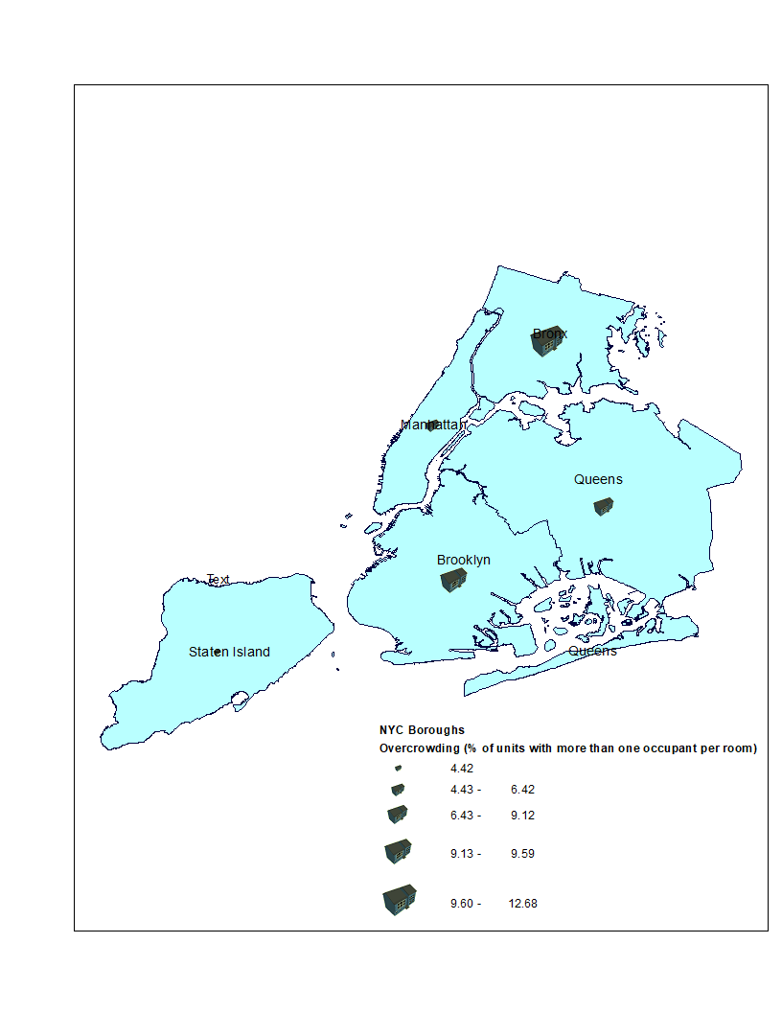
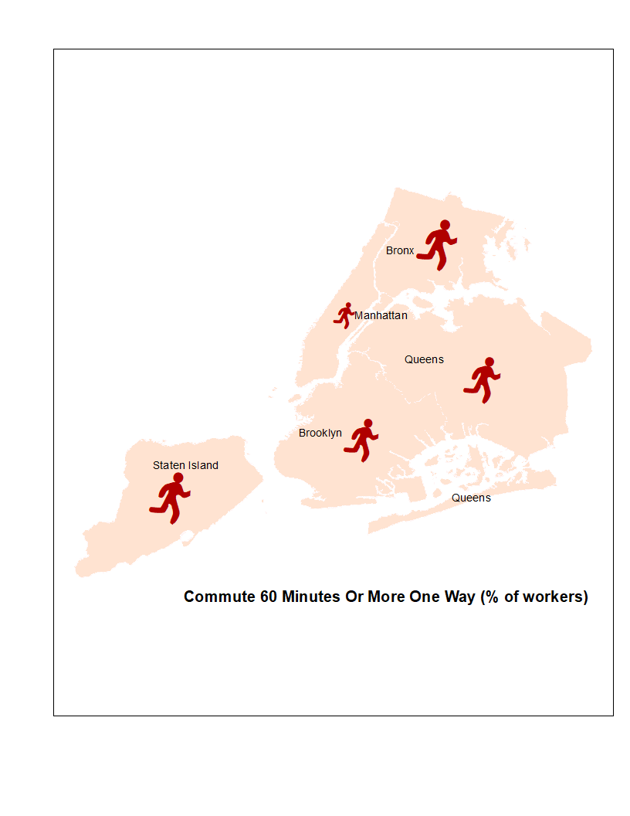
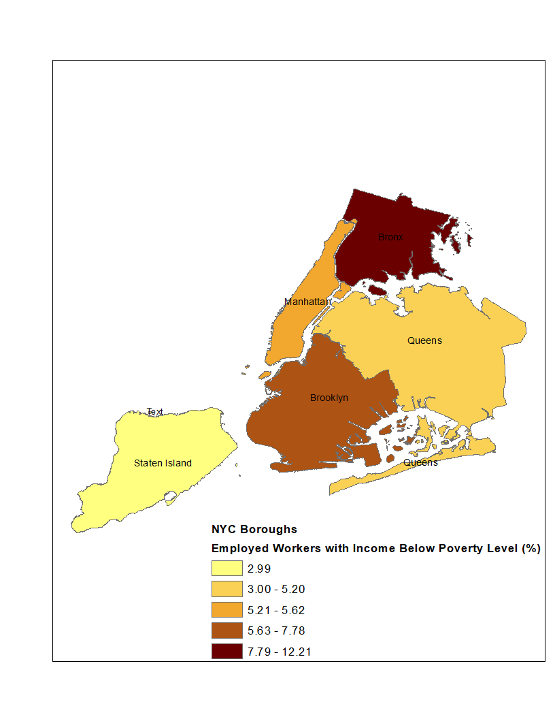
Data Visualization Contd…
NYC Socio Economic data

Slide 9
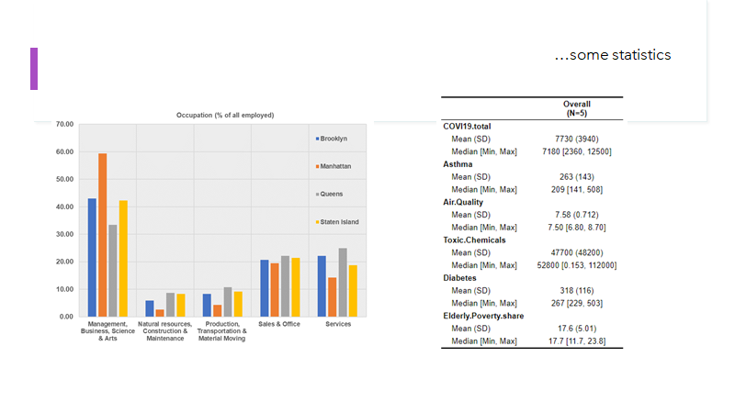
Some Statistics…

Slide 10
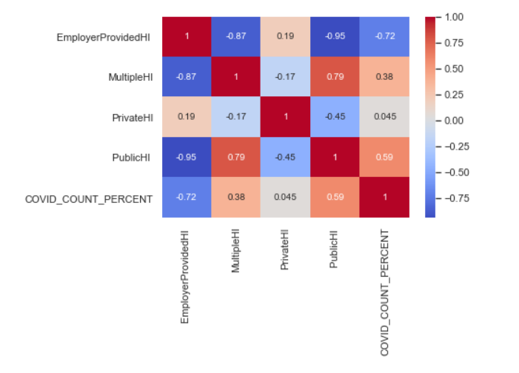
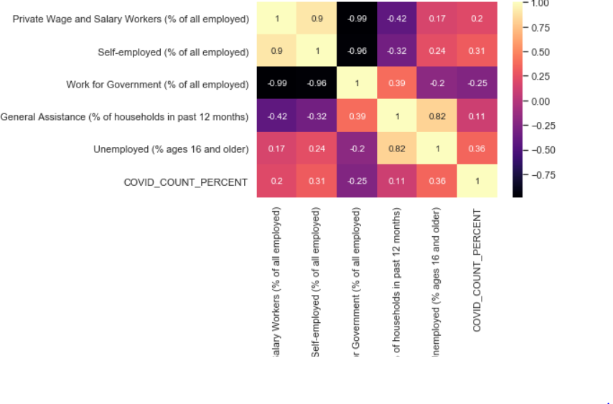
Feature Engineering: Corelation Matrix
Household with private or employer provided HI tend to have less covid-19 rate (negative correlation), while people having public or multiple are more likely to be at high risk of covid-19
Self employed and unemployed have higher correlation to COVID19 i.e. they are likely to be at high risk of COVID19.

Slide 11
Conclusion and Future Work
From this research project, it is concluded that the socioeconomic conditions like employment conditions, poverty, health insurance type, influences the probability of COVID19 risk to be higher.
Future Work
More granular data i.e. data at zipcode level.
A Regression algorithm can be run.
This study/analysis can be further spruced up and used to determine the riskier zones (prone to COVID19) of NYC.

Slide 12
References
Case Count, Hospitalized Count and Death Count on a particular date, by age and by sex. Downloaded this data from
https://github.com/nychealth/coronavirus-data
Data2GoNYC[1] (https://ssrc.formstack.com/forms/index.php) [we use the 4th edition]2. NYC Quarterly Economic Update (https://comptroller.nyc.gov/reports/new-york-city-quarterly-economic-update/)3. Data from the American Community Survey [https://www.census.gov/topics/preparedness/events/pandemics/covid-19.html]4. NYC Shapefiles for the maps – census tract (https://data.cityofnewyork.us/City-Government/2010-Census-Tracts/fxpq-c8ku)5. NYC Quarterly Economic Update (https://comptroller.nyc.gov/reports/new-york-city-quarterly-economic-update/)6. NYC Data/ Community Health Profiles Home (https://a816-health.nyc.gov/hdi/profiles/). [1]https://data2go.nyc/map/?id=107*36047015900*ahdi_puma!undefined!ns*!other_pop_cd_506~ahdi_puma_1~sch_enrol_cd_112~age_pyramid_male_85_plus_cd_20~median_household_income_puma_397~median_personal_earnings_puma_400~dis_y_perc_puma_102~poverty_ceo_cd_417~unemployment_cd_408~pre_k_cd_107!*air_qual_cd~ahdi_puma*family_homeless_cd_245#10/40.8278/-73.9586
Health Inequalities and Infectious Disease Epidemics: A Challenge for Global Health Security
https://www.ncbi.nlm.nih.gov/pmc/articles/PMC4170985/

